Slide 1

Custom Bootcamp – IDA (week 4)
Smriti Ravindran

Slide 2

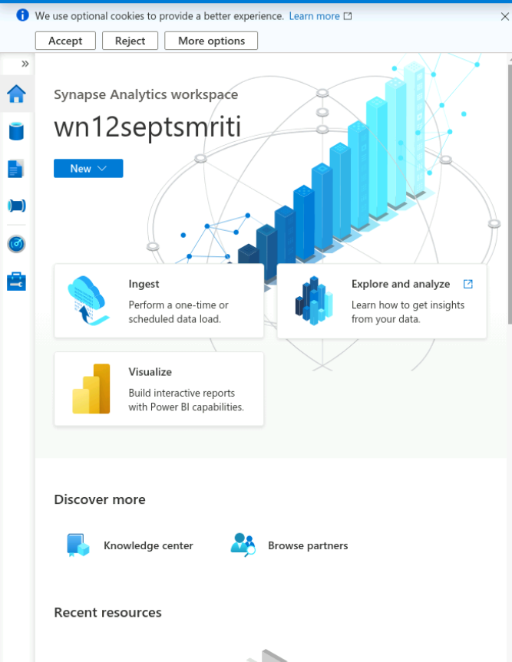
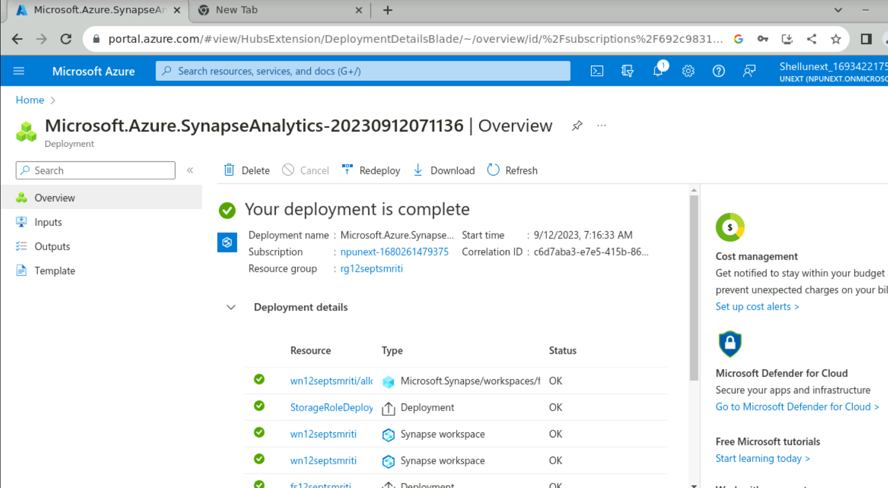
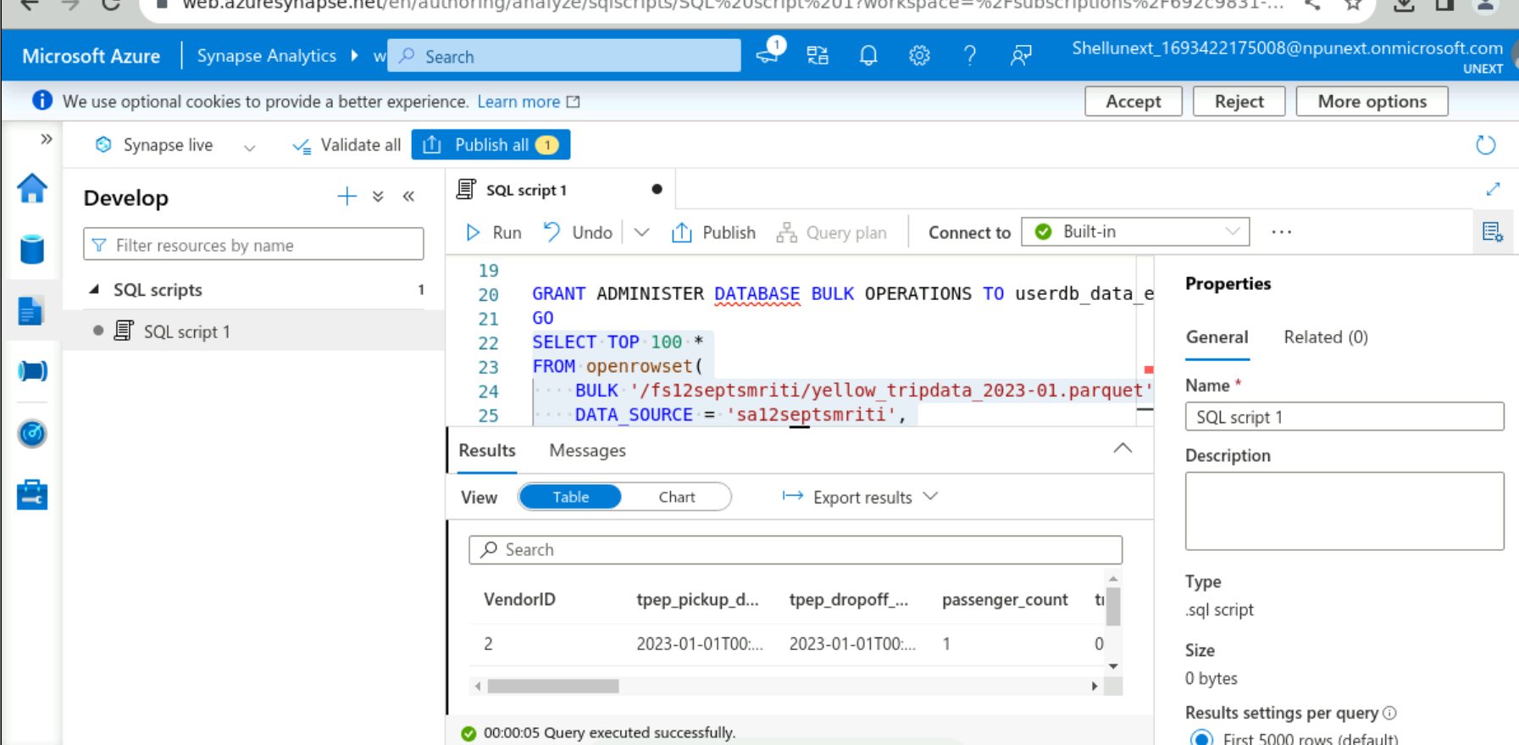
Azure Synapse

Slide 3
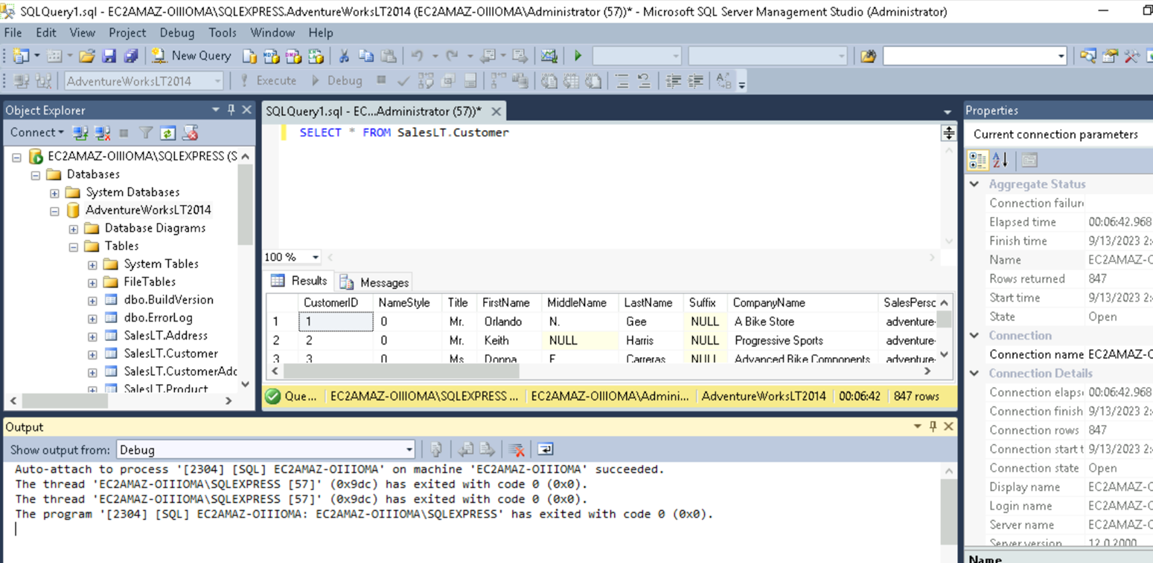
SQL Management Studio
Created tables and Inserted data into them which was further used to upload over PowerBI.

Slide 4
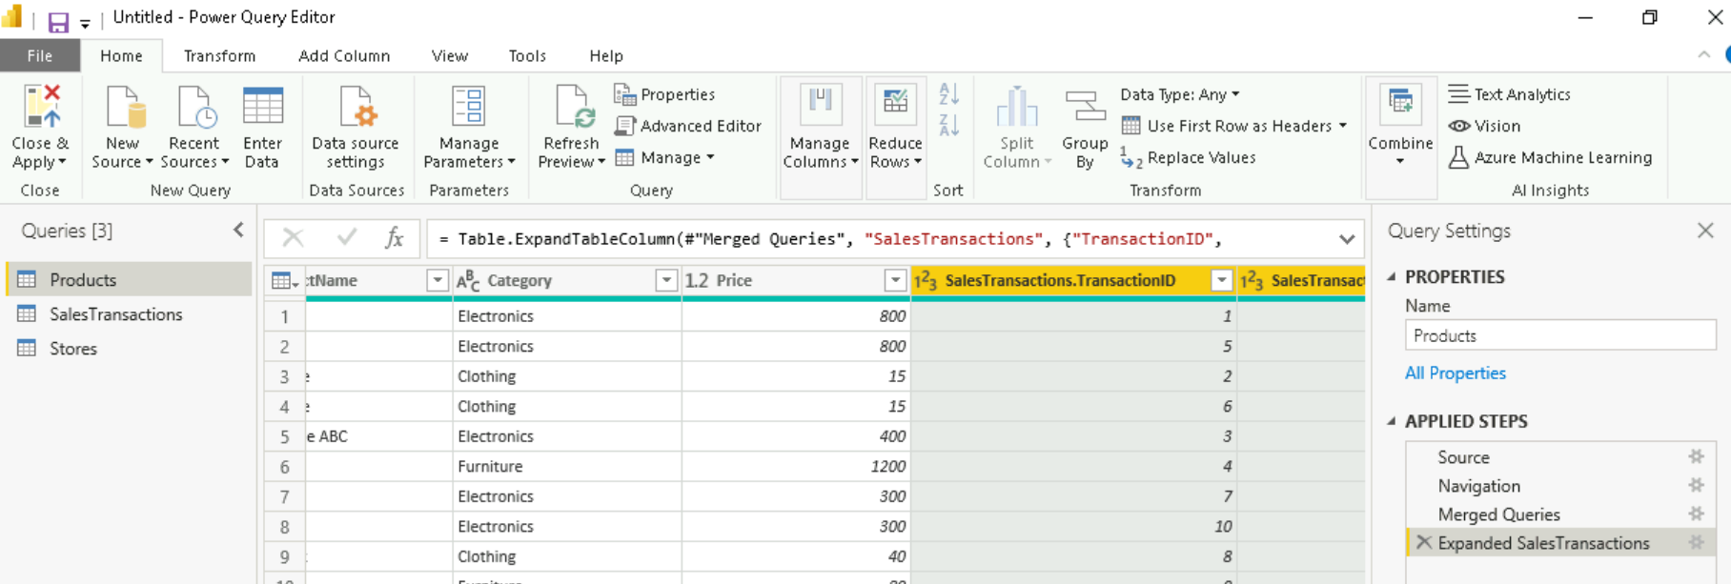
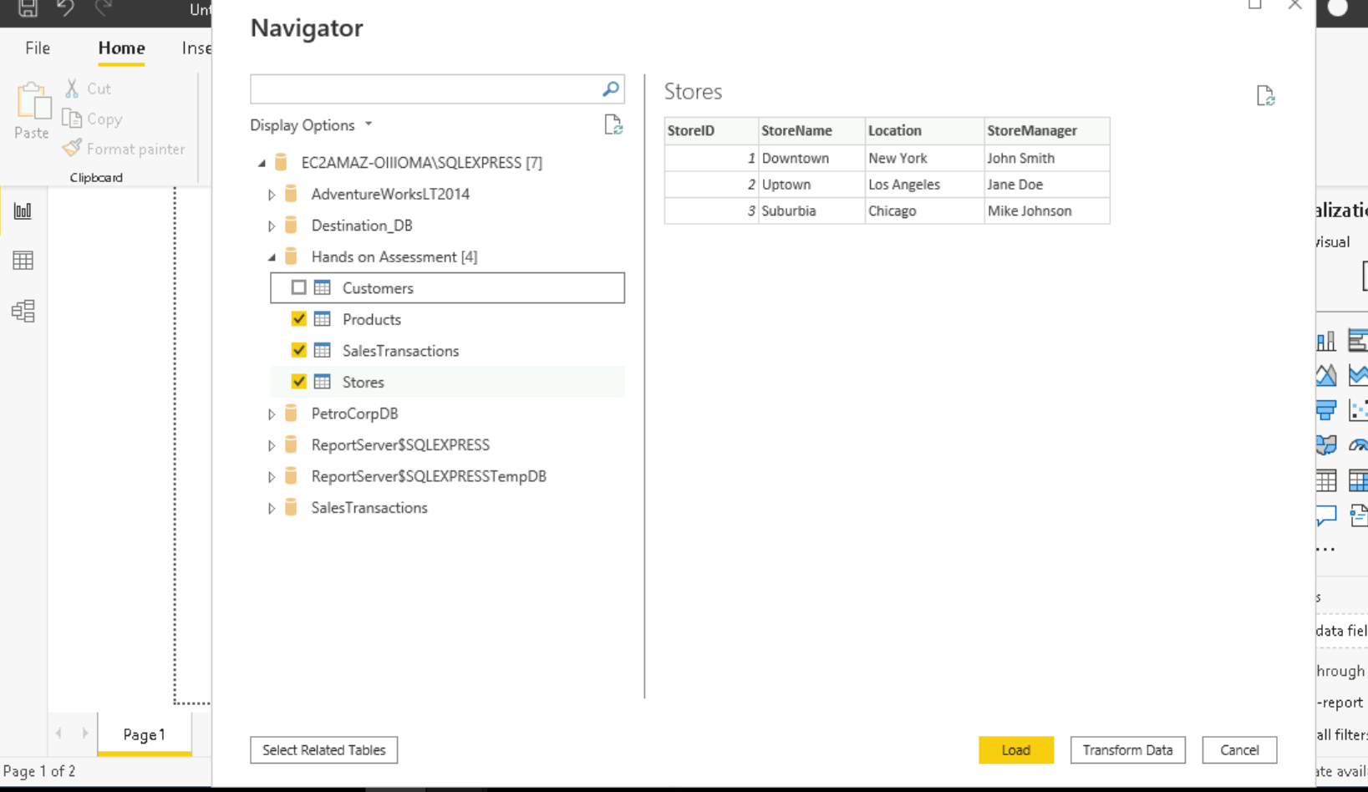
PowerBI
Created tables using SQL Management studio and further loaded the data to clean, filter and merge with other tables.
Used various tools to visualize data over PowerBI.

Slide 5
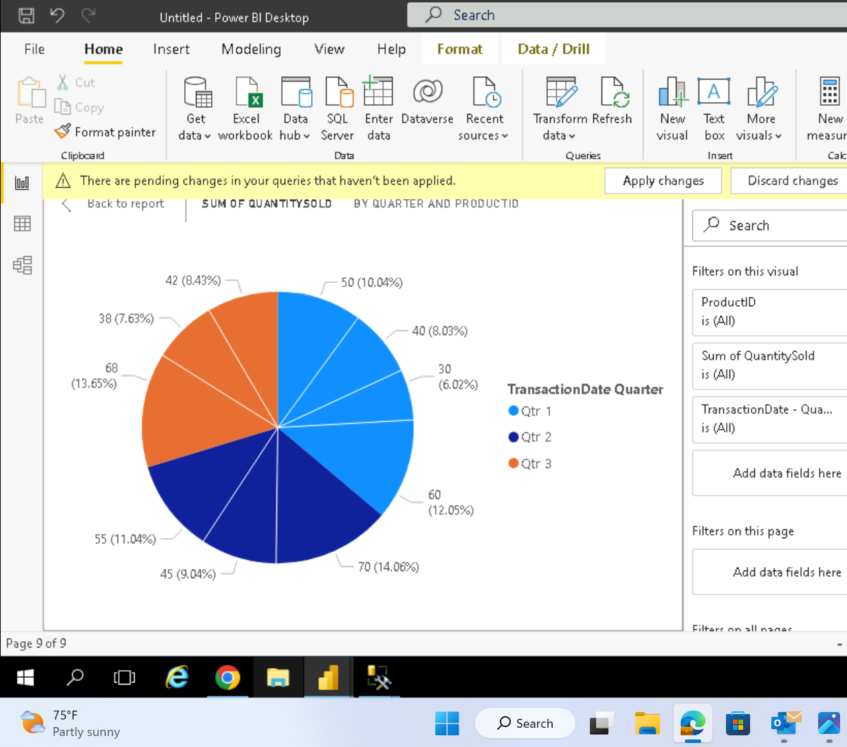
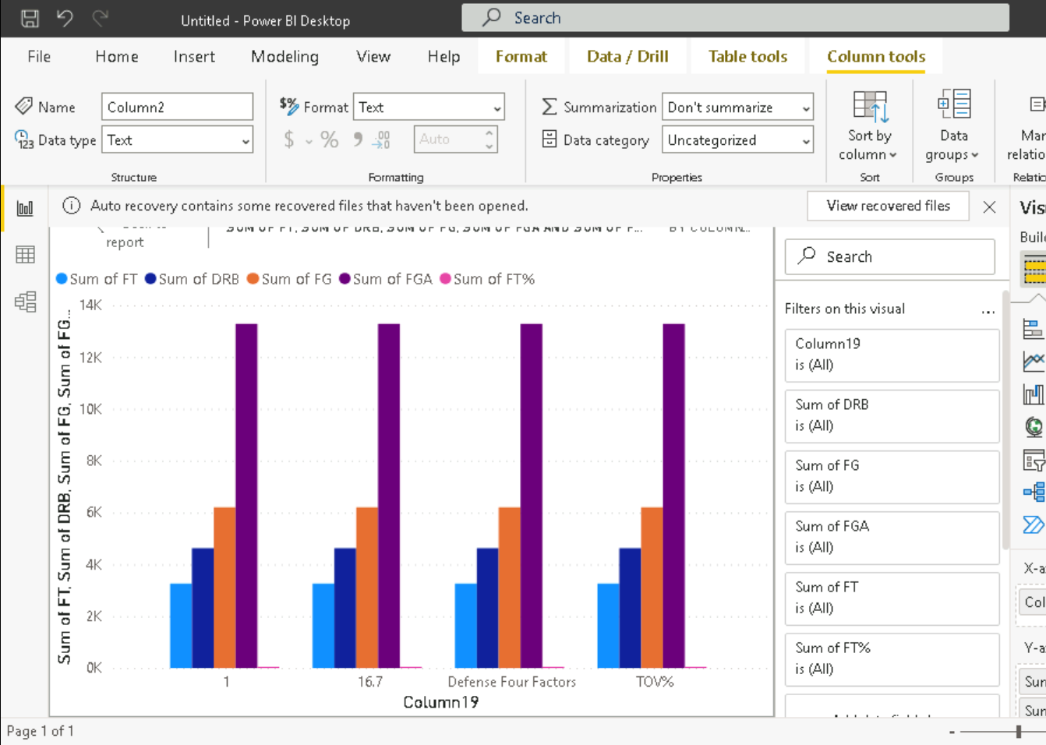
PowerBI Data Visualization
Created pie charts
Created Bar Plots

Slide 6
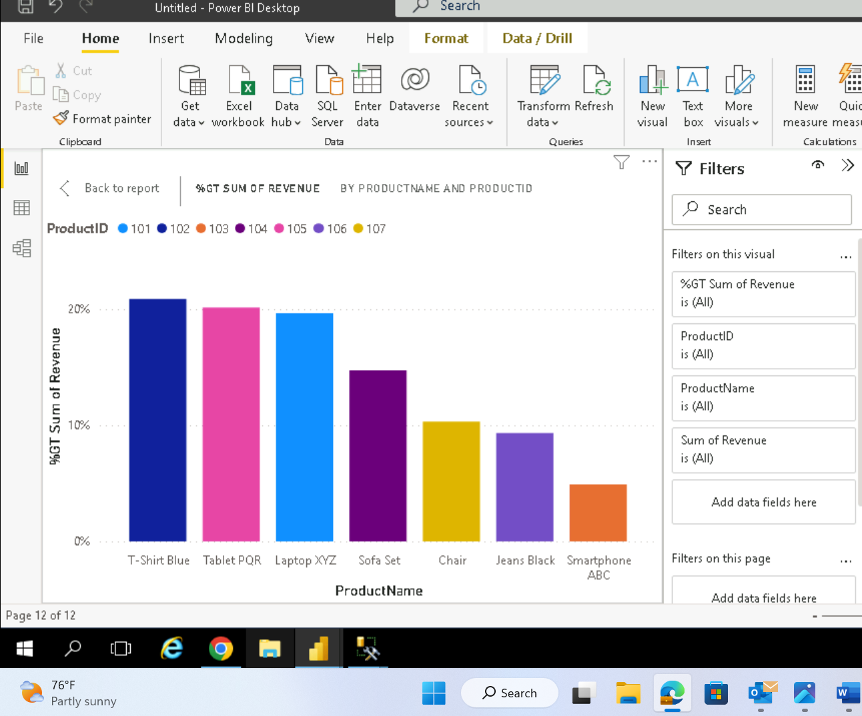
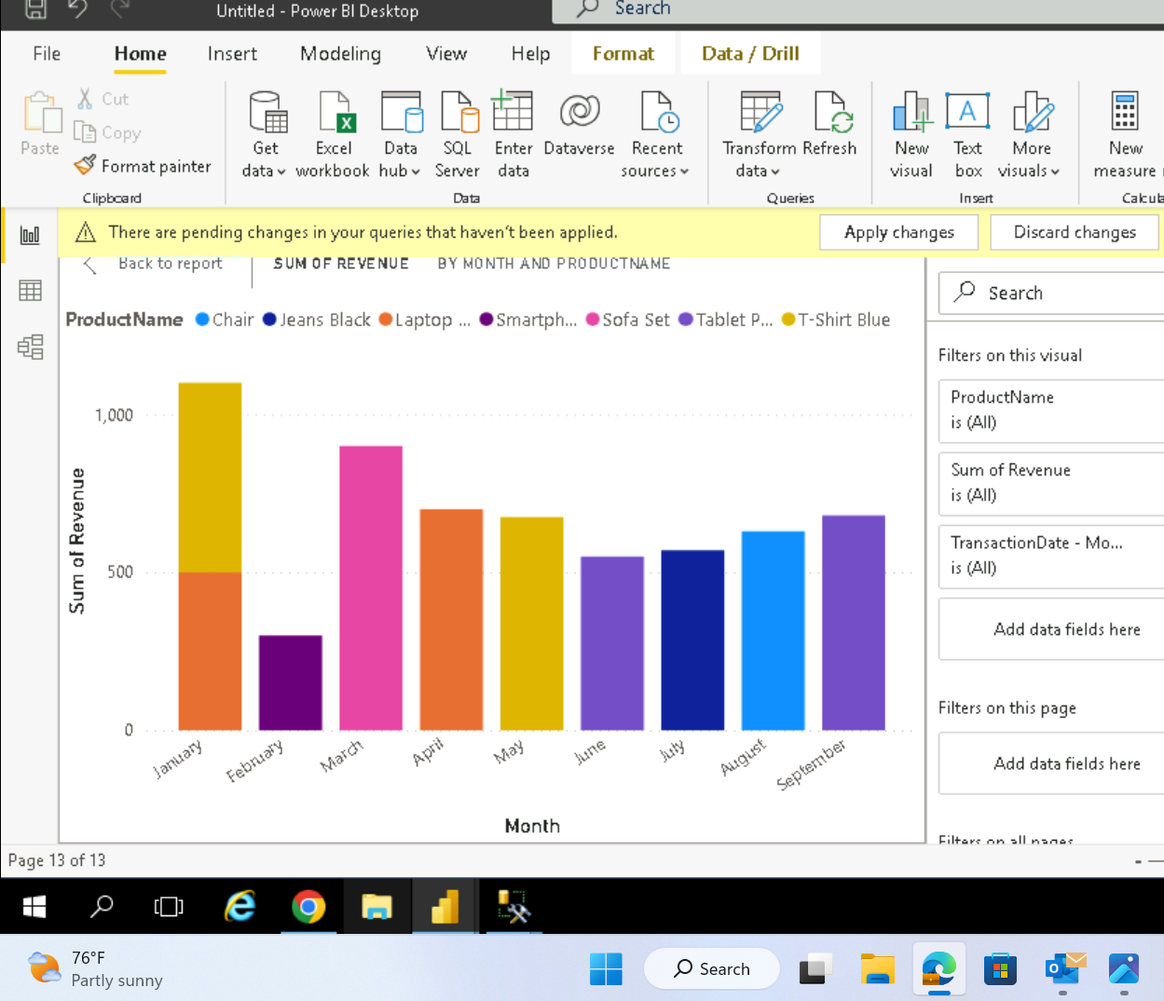
PowerBI Data Visualization

